Slide 1
FWD Project
TOGAF 9 - Core Diagrams
Product Lyfecycle Diagram
Phase B – Business Architecture

Slide 2
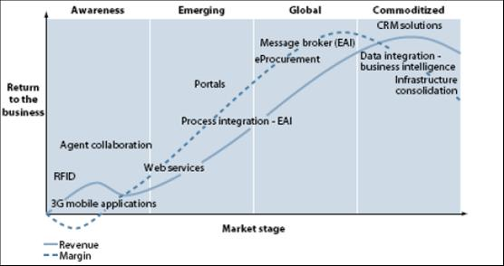
Product Lyfecycle Diagram

Slide 3
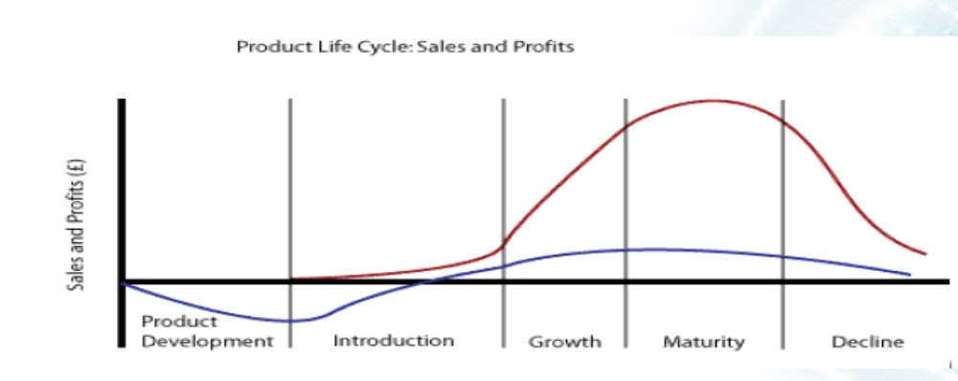
Product Lyfecycle Diagram

Slide 4
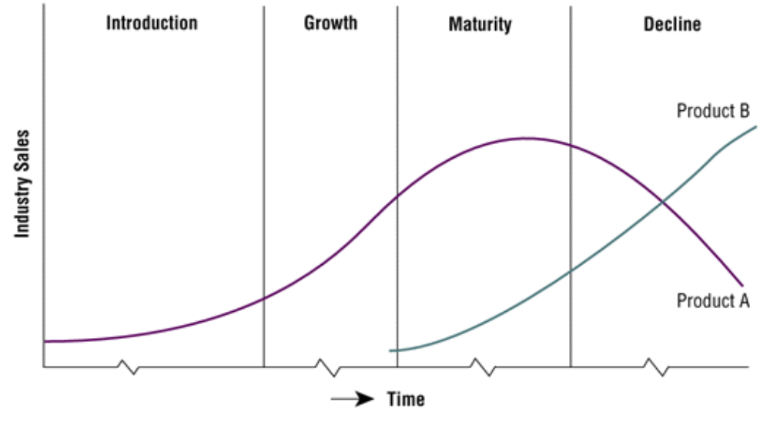
Product Lyfecycle Diagram

